Slide 1
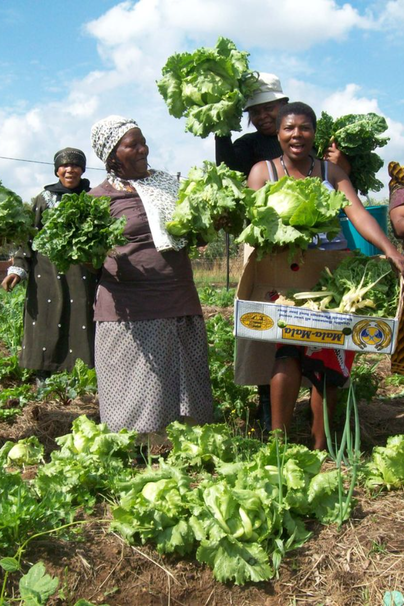

Solving Lack of Agricultural Advisory for South African Farmers
South African farmers face the challenge of limited access to timely and accurate agricultural advisory, hindering their productivity and overall success. With inefficient information dissemination, farmers struggle to make informed decisions for crop management, pest control, and maximizing yields. Our AI-powered platform aims to revolutionize agricultural advisory services, providing farmers with personalized, data-driven insights to optimize their farming practices and ultimately enhance their livelihoods.
Sa
by Sabeliwe Langa

Slide 2
Market Opportunity in South Africa
Potential for Growth
Challenges and Opportunities
South Africa's agricultural industry presents a significant market opportunity. The sector contributes to the country's economy and offers substantial potential for AI-driven agricultural solutions to thrive and make a meaningful impact.
The agricultural landscape in South Africa encompasses diverse climates and farming practices. This presents ample opportunities for our AI solutions to cater to the specific needs of different regions, crops, and farming methodologies.

Slide 3
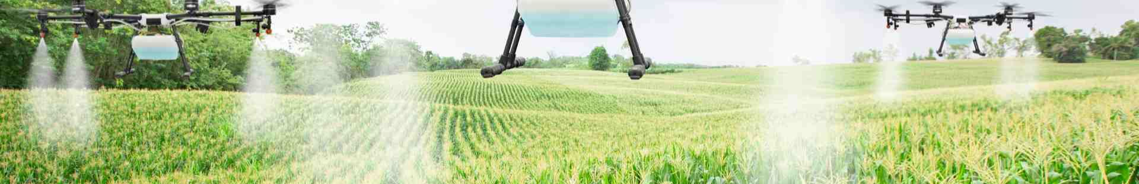
AI-Powered Agricultural Advisory Platform
1
Data-Driven Insights
2
Real-Time Recommendations
3
Accessibility and Inclusivity
Our platform leverages AI algorithms to analyze agricultural data and provide farmers with valuable, customized insights for their specific farming operations.
Through advanced technology, our platform offers real-time advisory, empowering farmers to make informed decisions promptly, leading to improved crop management.
We are committed to ensuring that our AI solutions are accessible and beneficial to small-scale and large-scale farmers alike, fostering inclusivity in the agricultural sector.

Slide 4

Key Features and Benefits
Precision Farming
Risk Mitigation
Cost Efficiency
Our platform enables precision farming by providing farmers with detailed insights and actionable recommendations at a granular level, optimizing resource utilization and yields.
By offering early detection of potential threats and diseases, our platform aids in risk mitigation, safeguarding farmers' crops and overall productivity.
Through data analysis and predictive modeling, our AI solutions contribute to cost-efficient agricultural practices, minimizing input wastage and maximizing returns.

Slide 5
Business Model and Revenue Streams
3
50K
Subscription Model
Licensing Agreements
Recurring subscription plans offering different tiers of features and support, ensuring sustainable revenue streams for the company.
Targeting partnerships with agricultural organizations and enterprises for licensing our AI solutions, creating substantial revenue opportunities.

Slide 6
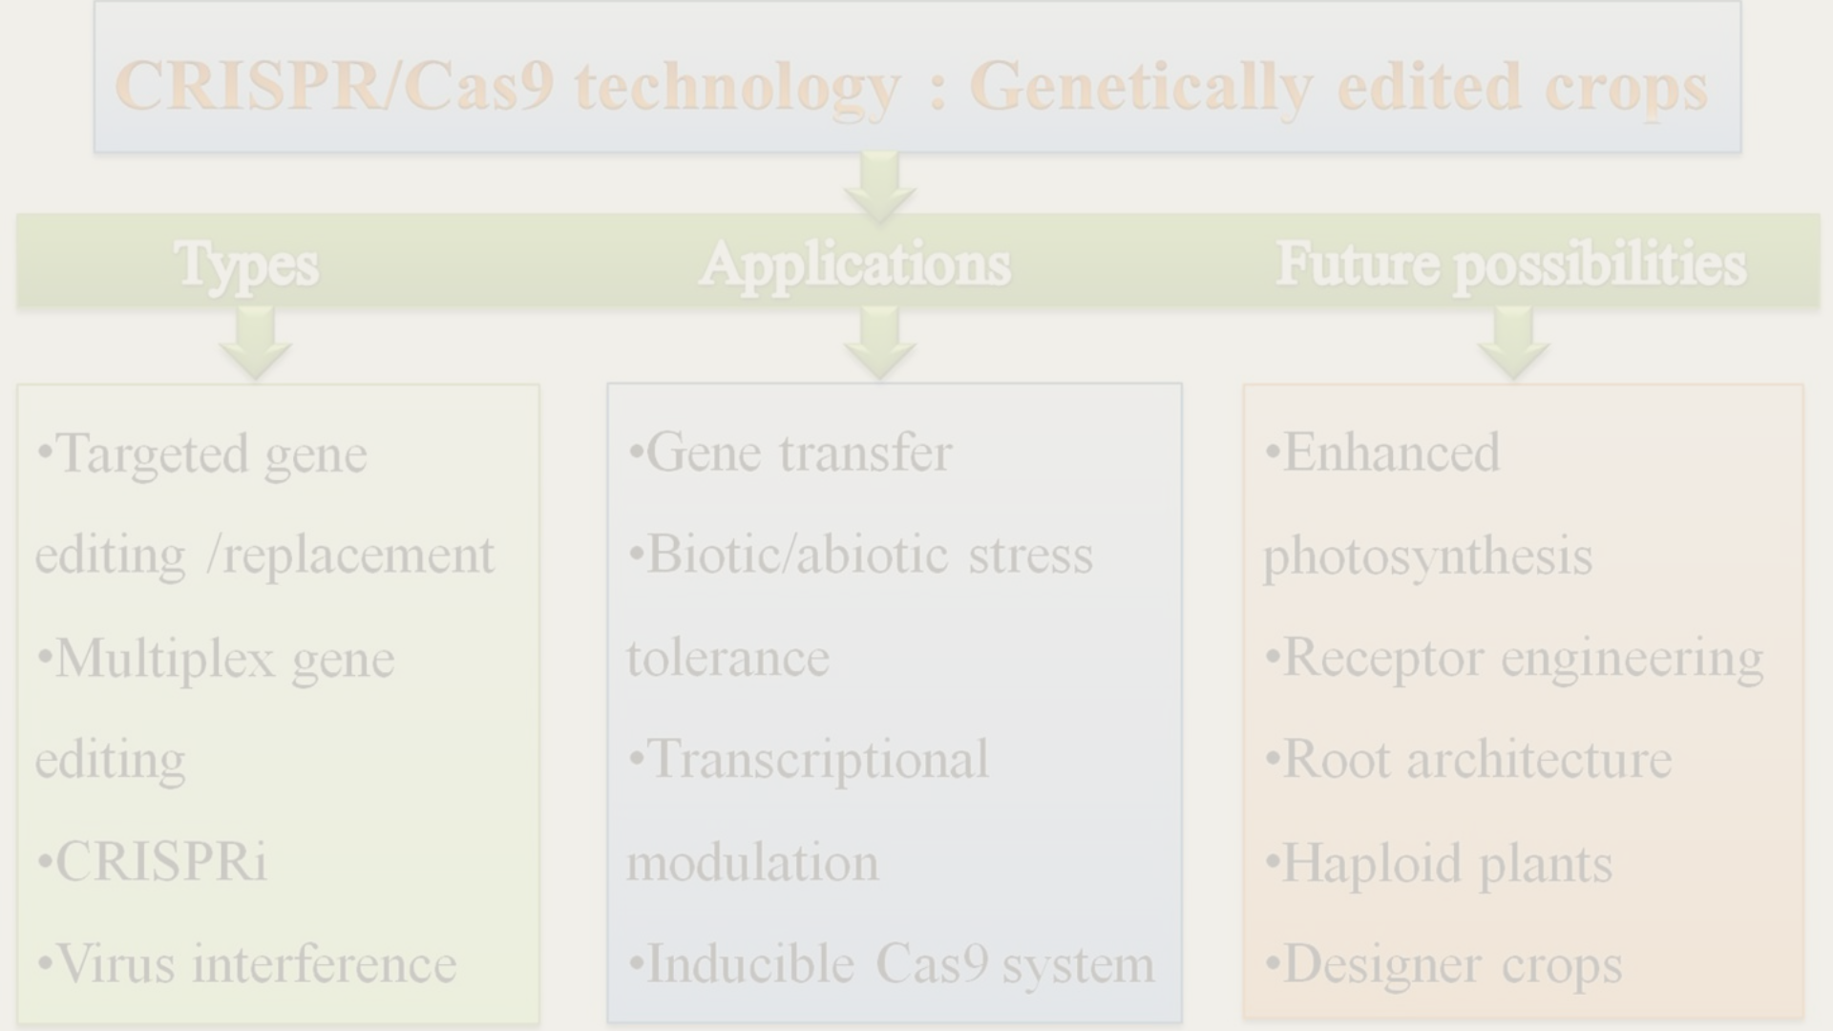


Market Validation and Testimonials
Farmer Testimonials
Industry Experts' Perspective
First-hand accounts from farmers demonstrating the tangible impact of our platform on their farming practices and overall crop yields.
Validation from renowned agricultural experts and organizations, acknowledging the transformative value our AI solutions bring to the sector.

Slide 7
Competitive Landscape and Unique Value Proposition
Analysis of Existing Solutions
Our Unique Value Proposition
Thorough assessment of current agricultural advisory platforms and technologies, highlighting the gaps in the market that our solution uniquely fills.
Emphasizing our platform's distinctive features, including real-time advisory and personalized insights, setting us apart in the competitive landscape.

Slide 8
Roadmap and Next Steps
1
Product Development
Initiating the development and refinement of additional features, ensuring continuous enhancement and innovation.
2
Market Expansion Strategy
Outlining plans for geographical expansion and strategic partnerships to reach a broader audience of farmers in South Africa.

Slide 9
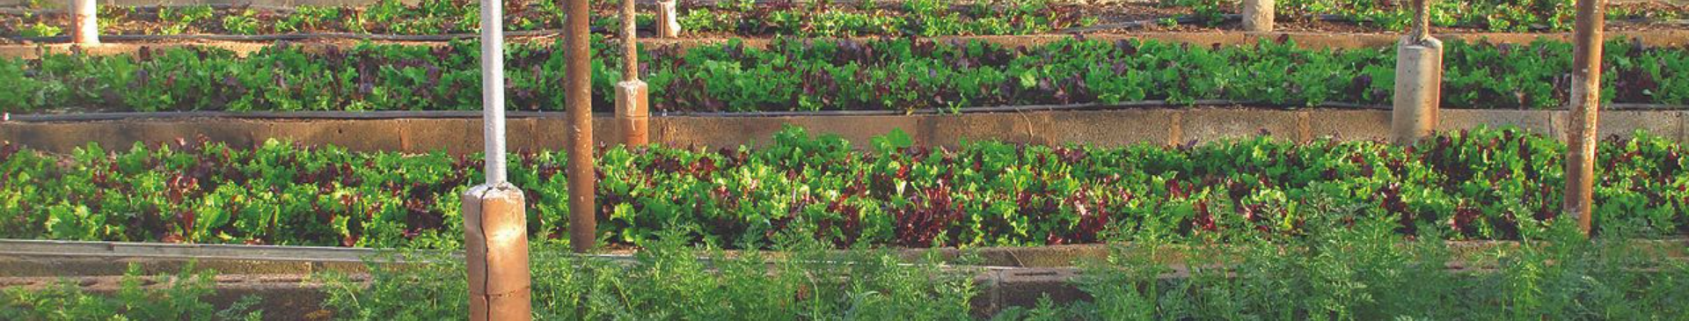
Our Ask
1
Investment Partnerships
2
Collaborative Alliances
Seeking strategic investors and partnerships to fuel the growth and scalability of our AI agricultural advisory platform.
Open to collaborating with industry stakeholders and organizations to collectively enhance the agricultural ecosystem in South Africa.

Slide 10
Our Team
Meet our diverse team of experts, comprising data scientists, agricultural specialists, and technology innovators, all driven by a common goal of revolutionizing agricultural advisory.

